Slide 1
Solution(Feature Parts)

Slide 2
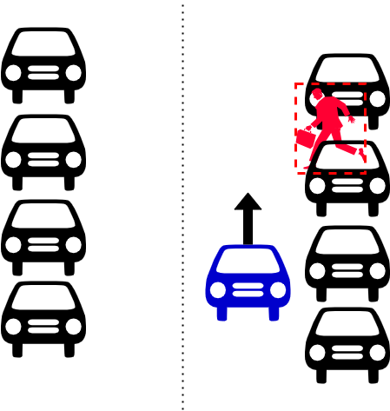
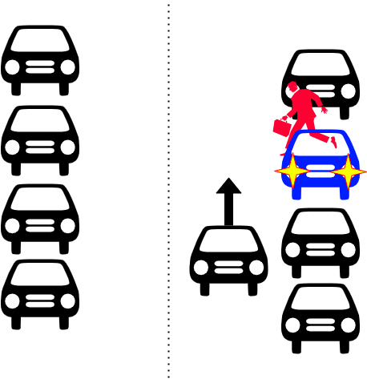
Solution(Feature Parts)
First Scenario
Second Scenario

Slide 3
Solution(Connectivity Parts)

Slide 4
The Product / Service
Our application is an innovative SDV safety system designed to reduce accidents caused by blind spots. It integrates detection and alert functionalities with OTA update, providing a scalable and adaptable solution for modern vehicles.

Slide 5

The Market
If we apply this technology to real vehicles, countries like Germany, which require EDR in all cars starting July 2024, or South Korea, where dashcam usage is high, can use it without needing extra hardware just by distributing the software.

Slide 6


Thank You slide
Thank your audience and encourage them to get in touch afterwards!
20-22 November, Karlsruhe, Germany
An Eclipse SDV Event

Slide 7
Thank You slide
Thank your audience and encourage them to get in touch afterwards!
20-22 November, Karlsruhe, Germany
An Eclipse SDV Event

Slide 8
Reference

